Slide 1
Subprime Markets
The Feasibility of Buying your First House

Slide 2
Outline
Outline
Definitions of Prime and Subprime Borrowers
Walk through example
How this played out during the recession
Key Points
Subprime versus Prime Borrowers
How the subprime market functions and the risks and benefits of the market
The power of interest rates

Slide 3
Subprime Markets
A market for those with questionable credit.
Can encompass different areas
Mortgages
Auto Loans
Credit Cards
Usually has a higher interest rate
30 Year Mortgage for $100,000 at discrete interest rates
Interest Rate | Payment
1% | $321.64
3% | $421.60
5% | $536.82
7% | $665.30
9% | $804.62

Slide 4
Prime vs Subprime Loan
Prime
Borrow has strong credit history
Measurements
Credit Score ~660 or higher
LTV ~Less then 95%
PTI (Front End) ~No more then 28%
Subprime
Borrower does not have strong credit history
Measurements
Credit Score ~Lower then 660
LTV ~Greater then 95%
PTI (Front End)~More then 28%
Notes:
FICO- ranges between 350 and 850
PTI- Total monthly payments/pretax monthly income (Front End)
ARM Held in check by
Periodic Cap
Lifetime Cap
Determined by-
Market Determined Rates (LIBOR)
Calculated rates based on the funds for thrifts

Slide 5
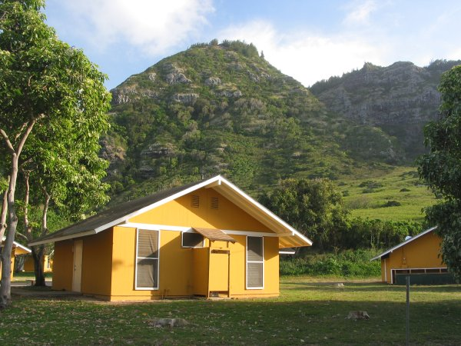
Your Dream Home: 2005
You want to purchase your dream house in a tropical place with nice neighbors
How might your experience vary if you are utilizing the subprime market?

Slide 6
Loan Details
 | Prime | Subprime
Loan Type | 30 Year Fixed | 30 Year Floating Rate
Loan Amount | $250,000 | $250,000
Closing Costs | $7,000 | $7,000
Total Needed | $257,000 | $257,000
Downpayment | $12,500 | -$7,000
LTV | 95% | 103%
Total Borrowed | $244,500 | $257,000
Notes:
Talk about floating rate and fixed rate

Slide 7
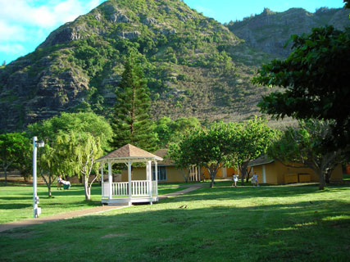
Payment Details
Payment Details
Interest Rate | 6% Fixed Rate | 6% Adjustable
Initial Payment (3 Years) | $1,466 | $1,541
Adjustable Rate (9%) | $1,466 | $2,033
Notes:
Borrow 250k you expect equity to go up to 273, can get raise or sell

Slide 8
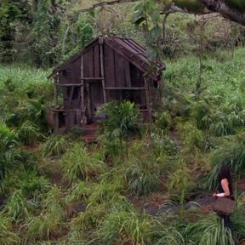
What Went Wrong?
You take out a subprime mortgage for 257k
Instead of rising in value your home is now worth 200k

Slide 9
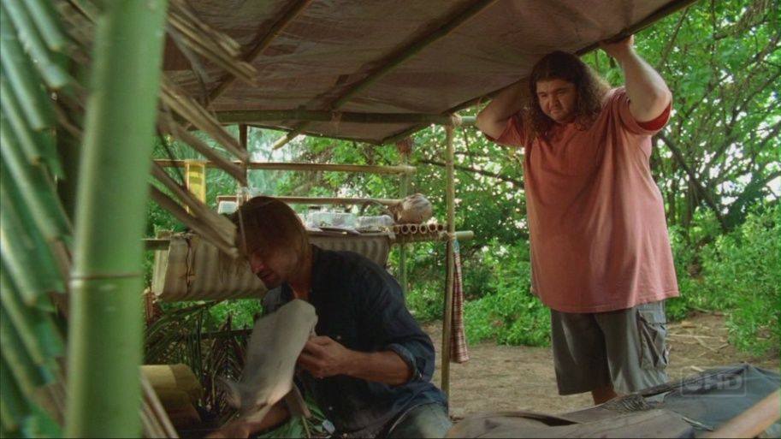
What do you do?
Get second job to pay for mortgage
Also Economic Recession
Pay on Mortgage for 257k when house is worth 200k
Walk away and go live on the beach

Slide 10

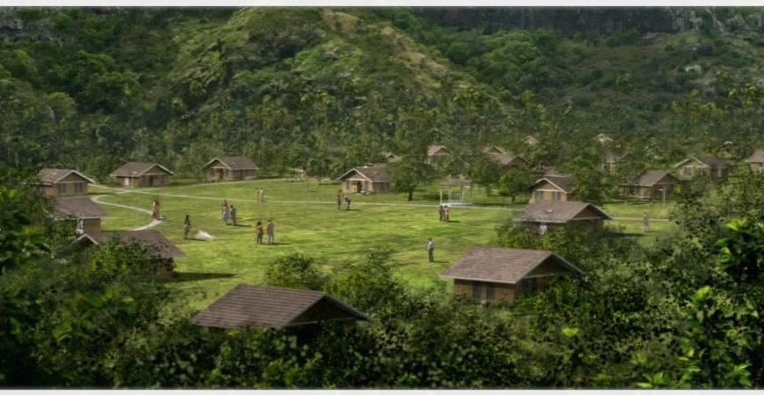
Economic Crisis
Why would you take out:
Adjustable rate mortgage?
Subprime Mortgage?

Slide 11
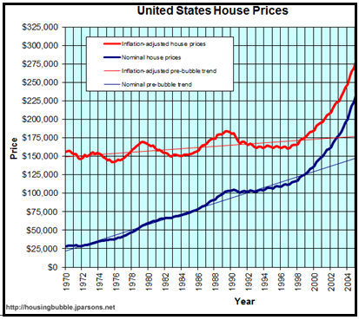
Housing Market: Up to 2005
Price of housing on average going up around $25,000 every two years

Slide 12
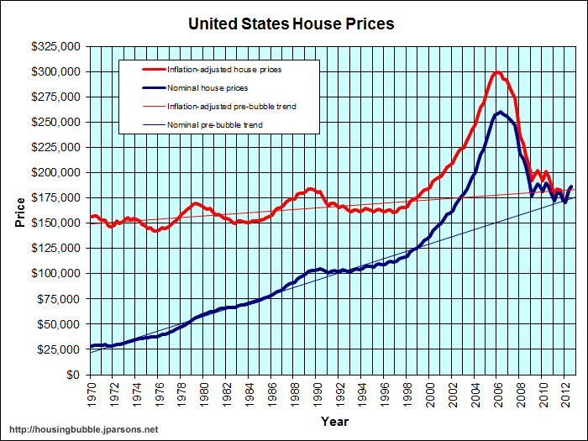
Housing Market: Through 2012
Supply Up and Demand Down
Bad for Investors
Bad for mortgage holders
Bad for Economy

Slide 13
US Mortgage Market

Slide 14
Subprime Markets: The Fallout

Slide 15

Questions?
The First Council of Nicaea, in 325, forbade clergy from engaging in usury). At the time, usury was interest of any kind, and the canon merely forbade the clergy to lend money on interest above 1 percent per month (12.7% APR)
In Dante’s Inferno usurers are placed in the inner ring of the seventh circle of hell
"When money is lent on a contract to receive not only the principal sum again, but also an increase by way of compensation for the use, the increase is called interest by those who think it lawful, and usury by those who do not." (William Blackstone's Commentaries on the Laws of England).

Slide 16
Questions?

Slide 17
References
Federal Housing Finance Agency. Federal Reserve Bank of St. Louis. All-Transactions House Price Index for the United States . 2012. Web.
Manchester, Joyce M. and James M. Poterba, 1989. “Second Mortgages and Household Saving,” Regional Science and Urban Economics, 19(2), 325-346.
Fabozzi, Frank, Franco Modligliani, and Frank Jones. Foundations of Financial Markets and Institutions. 4th. Boston: Prentice Hall, 2010. Print.
Bianco, J.D., Katalina. "The Subprime Lending Crisis: Causes and Effects of the Mortgage Meltdown." CCH Mortgage Compliance Guide and Bank Digest. (2008): n. page. Print.

